Slide 1
SOM : Self Organizing Map
Prepared By : Meghej Khandelwal
Batch : TS : IIT-NIT
PS No. : 40016944

Slide 2
Outline:
Today we will be discussing :
What is SOM ?
Why we need SOM ?
How SOM is implemented into practice ?
Cons of SOM ?

Slide 3
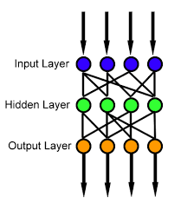
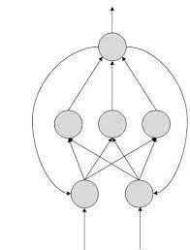
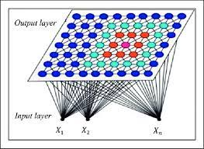
What is SOM ?
History :
Introduced by Finnish professor Teuvo Kohonen in the 1980s
Three philosophical models were proposed for working of brain :
Feedforward Networks : In a feedforward network, information always moves one direction; it never goes backwards.
Feedback Networks : The output goes back into the network. The feedback network feeds information back into itself and is well suited to solve optimization problems.
Self Organizing : Competitive, Collaborative and Adaptivity, unsupervised learning.
Image Source: Wikipedia
Image Source: TutorialsPoint
Image Source: Research Gate
Feedforward Networks
Feedback Networks
Self Organizing Networks

Slide 4
SOM is a type of ANN trained using unsupervised learning
Method for dimensionality reduction converting continuous inputs into discrete outputs.
There are 2 popular model of SOM :
Willshaw Von-der Malsburg Model
Kohonen Model
Essential Processes in the formation of self-organizing map:
Competition: Each neuron computes discriminant function and the neuron with largest discriminant wins.
Cooperation: The winning neuron will determine the spatial location of topological neighborhood of the excited neurons.
Synaptic Adaptation: Enables the excited neurons to increase their individual values of discriminant function in relation to the input pattern.

Slide 5
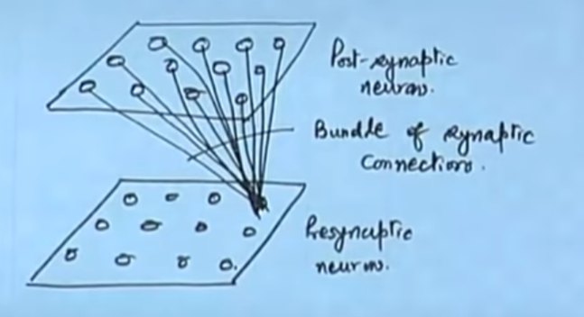
Willshaw Von-Der Malsburg Model
=> Input dimensions is same as output dimensions.
=> This model was used to explain the retina-optic mapping from
=> Electrical Signals of the presynaptic neurons are based on geometric proximities.
Post Synaptic Neurons
Bundle of Synaptic Connections
Presynaptic Neurons
Source : Nptel Lectures By S Sengupta on course : Neural Networks and Applications (Lec 35,36,37)

Slide 6
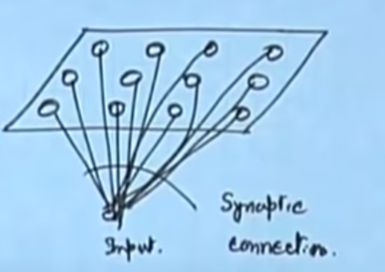
Kohonen Model
=> More generalized model where only output layer is organized, the inputs can be unorganized.
=> Based on vector coding algorithm
=> Optimally places fixed number of vectors (codewords) into a higher dimensional input space.
=> This is used in data compression.
Synaptic Connections
Input
Source : Nptel Lectures By S Sengupta on course : Neural Networks and Applications (Lec 35,36,37)

Slide 7
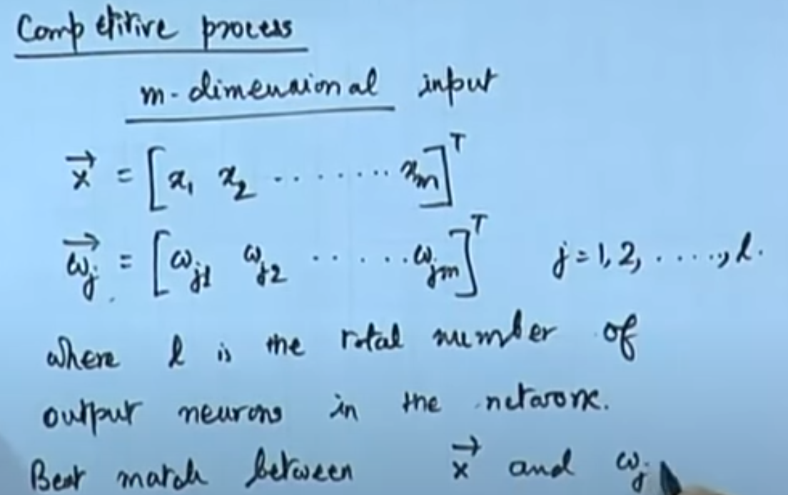
Mathematical Modelling of the three processes of SOM
COMPETITION:
Source : Nptel Lectures By S Sengupta on course : Neural Networks and Applications (Lec 35,36,37)

Slide 8
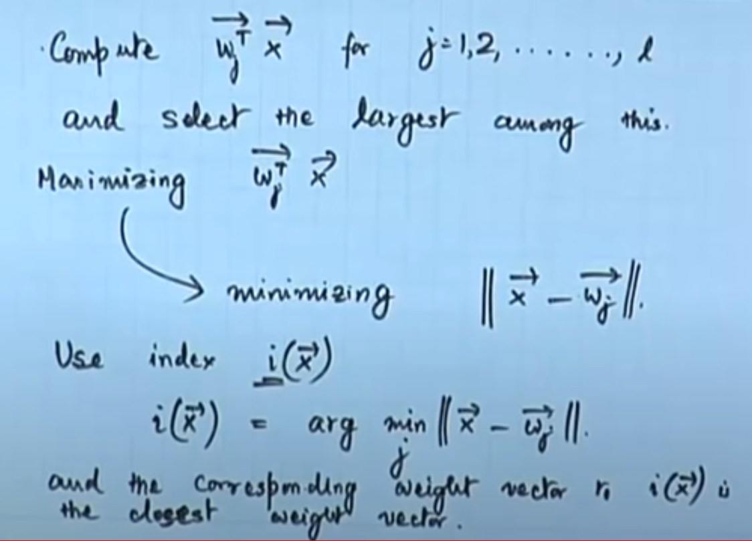
Result :
A continuous input space of pattern is mapped into discrete output space by process of competition
Source : Nptel Lectures By S Sengupta on course : Neural Networks and Applications (Lec 35,36,37)

Slide 9
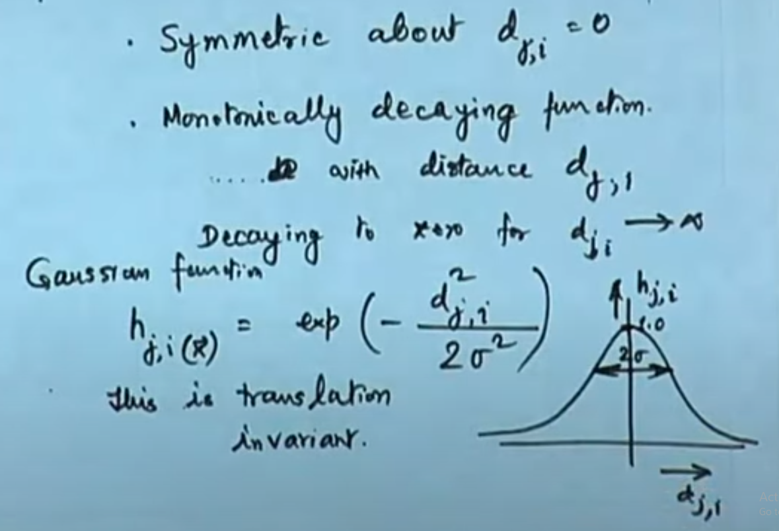
Cooperation:
When a neuron is fired then it also excites the neurons in its surrounding
Hence Neighborhood Function has to be max. When near the winner and gradually decrease while getting away from the winner
Topological Neighborhood
Source : Nptel Lectures By S Sengupta on course : Neural Networks and Applications (Lec 35,36,37)

Slide 10
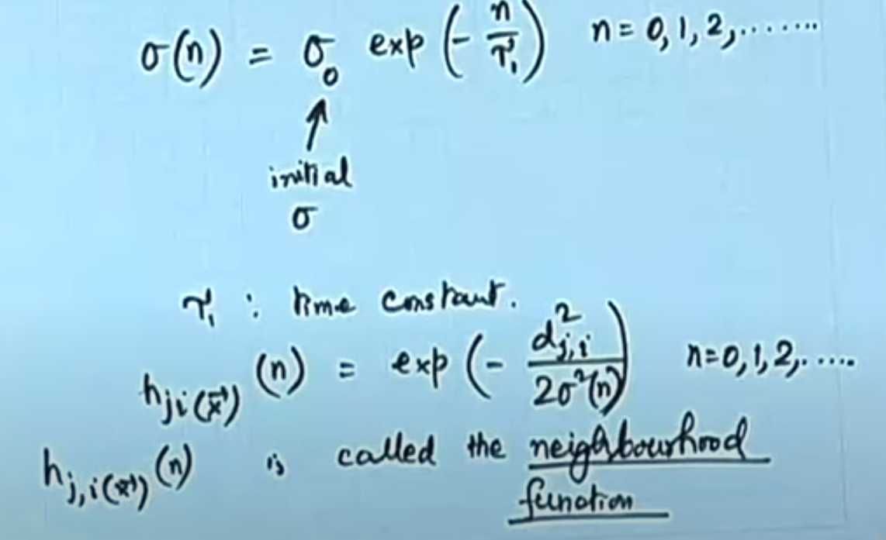
σ shrinks with iterations so as to eliminate neighbors slowly. And with sigma shrinking, hji will also decrease.
Source : Nptel Lectures By S Sengupta on course : Neural Networks and Applications (Lec 35,36,37)

Slide 11
Adaptation:
Learning Mech. Employed mostly for SOM is Hebbian learning
It is a single layer neural network, i.e. it has one input layer and one output layer.
Hebbian rule works by updating the weights between neurons in the neural network for each training sample.
Limitation of Hebb Rule : Weight will saturate on feeding same training patterns and to stop overlearning, we have to introduce a forgetting term.

Slide 12
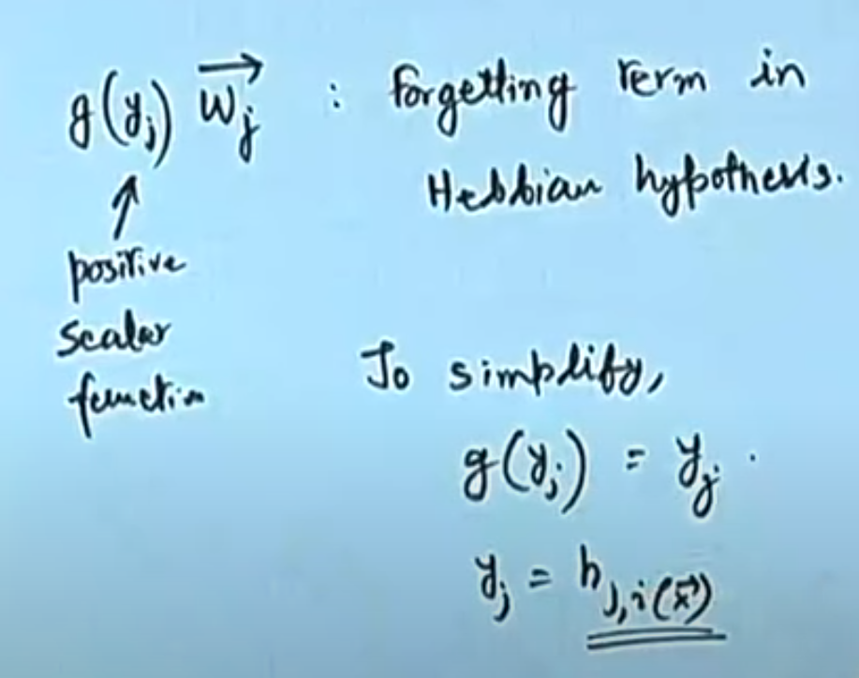
Source : Nptel Lectures By S Sengupta on course : Neural Networks and Applications (Lec 35,36,37)

Slide 13
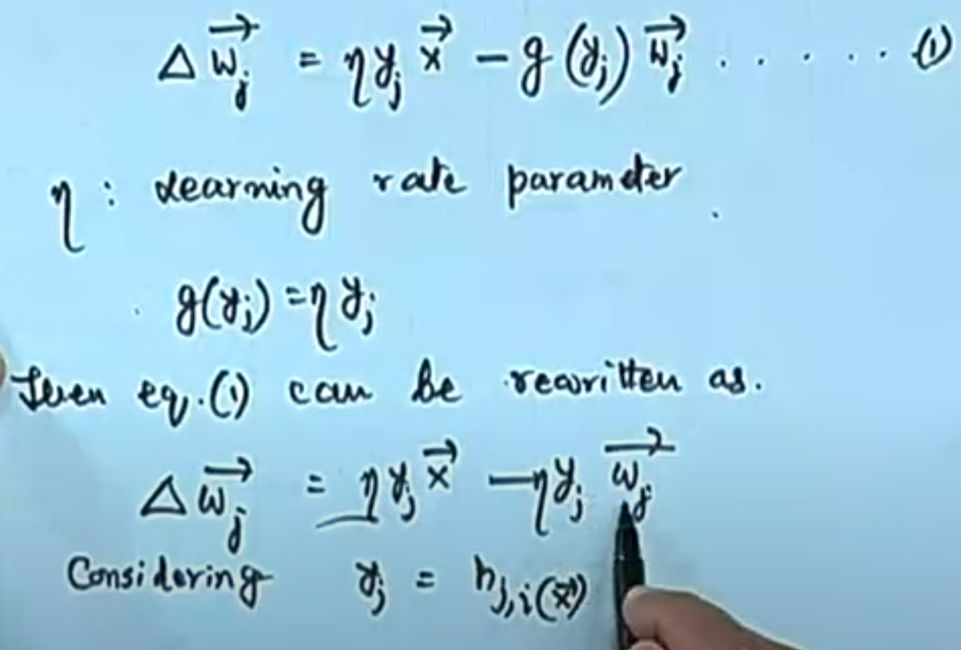
Source : Nptel Lectures By S Sengupta on course : Neural Networks and Applications (Lec 35,36,37)

Slide 14
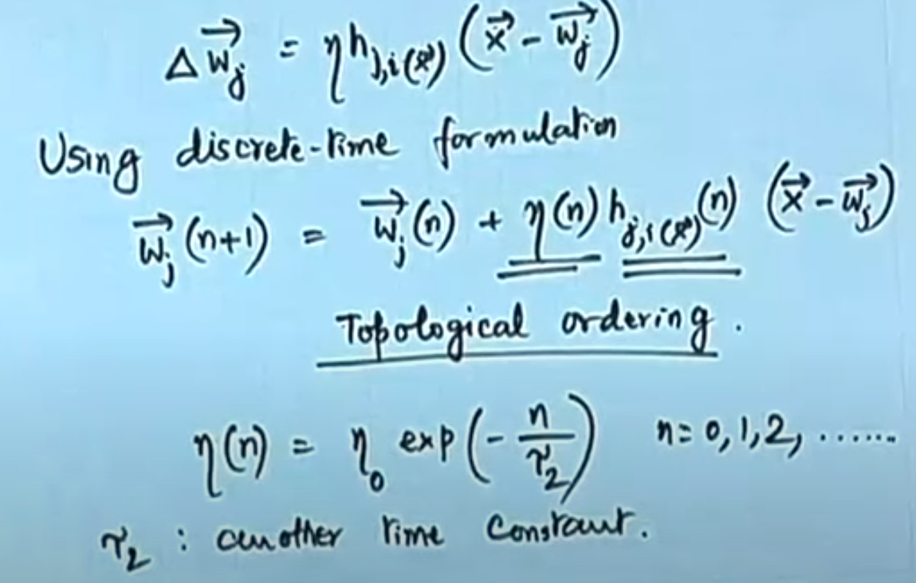
Source : Nptel Lectures By S Sengupta on course : Neural Networks and Applications (Lec 35,36,37)

Slide 15
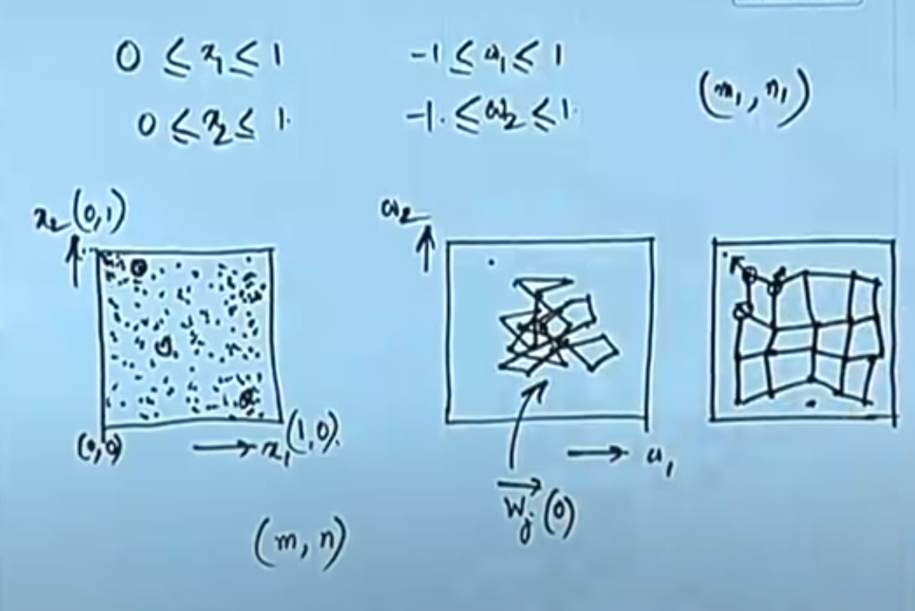
Source : Nptel Lectures By S Sengupta on course : Neural Networks and Applications (Lec 35,36,37)

Slide 16
Why SOM ?
Other ANNs apply error reduction techniques (like backpropagation with gradient descent)
SOM applies competitive learning technique where a neighborhood function is used to preserve the topological properties of the input space.
Data is easily interpreted and understood.
Reduction in dimensionality simplifies equations and calculations.

Slide 17
How SOM is used in practical life ?
Statistical pattern recognition, especially recognition of speech
Control of robot arms, and other problems in robotics
Control of industrial processes, especially diffusion processes in the production of semiconductor substrates
Image compression
Credit Card Fraud Detection
Sentence understanding
Automatic synthesis of digital systems
Telecommunications
Classification of insect courtship songs

Slide 18
References :
=> Nptel Lectures By S Sengupta on course : Neural Networks and Applications (Lec 35,36,37)
[https://nptel.ac.in/courses/117/105/117105084/]
=> Research Paper [T. Kohonen, "The self-organizing map," in Proceedings of the IEEE, vol. 78, no. 9, pp. 1464-1480, Sept. 1990, doi: 10.1109/5.58325.]
=> Wikipedia
=> Medium Blog [ https://medium.com/@abhinavr8/self-organizing-maps-ff5853a118d4 ]

Slide 19
Any Questions ?
Thank You Very Much !!!

